Slide 1

Cybersecurity in Autonomous Vehicles
Ahmed Terchoun, Mohamed Ahmed, Md Zihan, Mahin Ullah
CMPS385 – Computer Security

Slide 2
Autonomous Vehicles
What are autonomous vehicles?
Essentially a self-driving car, or a car that incorporates some form of vehicular automation
Capable of sensing its environment and move safely with little human input

Slide 3
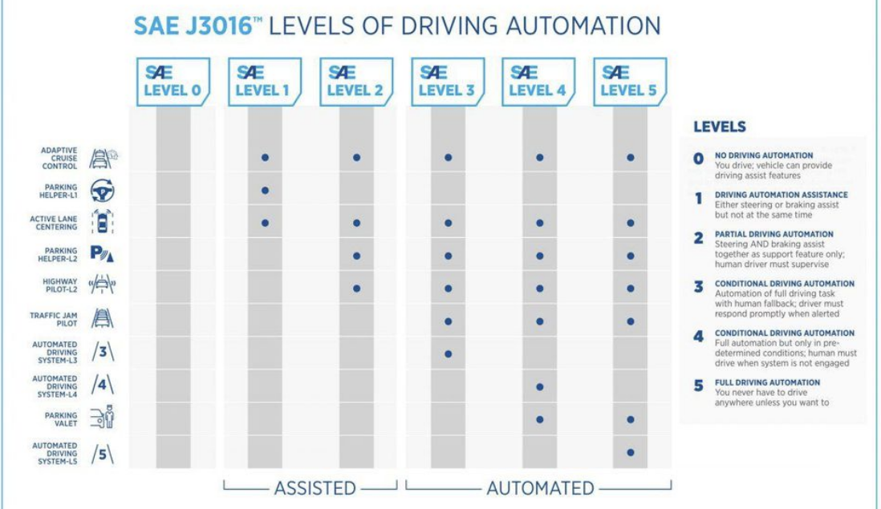

Slide 4
“Computer”
One of the most crucial parts of an autonomous vehicle is the computing system
to have a working autonomous vehicle it is essential the vehicle understands the environment and its surroundings to make decisions in real time.
These vehicles are armed with sensors, radars, cameras, and computational devices to translate that raw data into information.
This allows the vehicle to be a “computer” and with that it covers a majority of the production including computation, power management, storage, and full-stack software

Slide 5
How are Connected and Autonomous Vehicles possible?

Slide 6

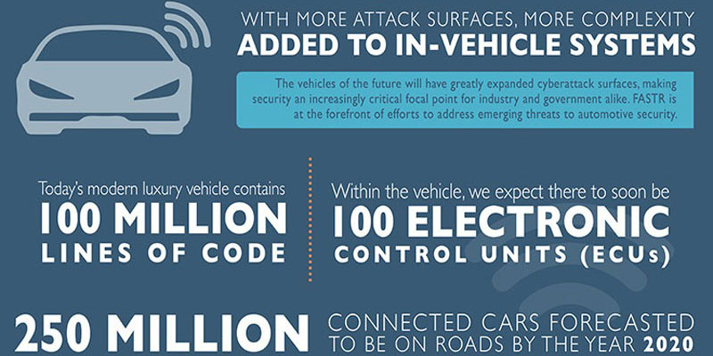



Lines of Code
Notes:
Because of lines of code, there are hundred million lines of code in today’s modern luxury vehicle’s and
In addition, there is something called the (next slide)

Slide 7
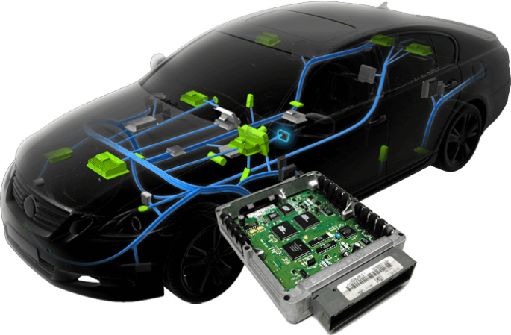
Electronic Control Unit (ECU)
Which is a small device in a vehicle’s body that is responsible for controlling a specific function.
Notes:
An ECU is a very small car component - (known as car-puter) - with internal chips that are very similar to the ones we have at home, such as laptops.

Slide 8

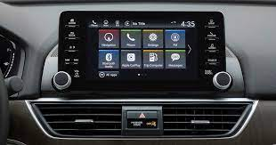

Navigation having its own Electronic Control Unit
Infotainment have its own Electronic Control Unit
Brake system have its own Electronic Control Unit
- Which means that there are more attack surfaces and more complexity in today's in-vehicle system.
- How does all that affect us ?
Well, it affect us because these vehicles can now be (hacked).
Notes:
So imagine, Navigation have one electronic control unit, infotainment having one electronic control unit, and breaking system have its own electronic control unit
And all of these electronic control units which control specific aspect in the vehicle and each of them have their own line of code

Slide 9
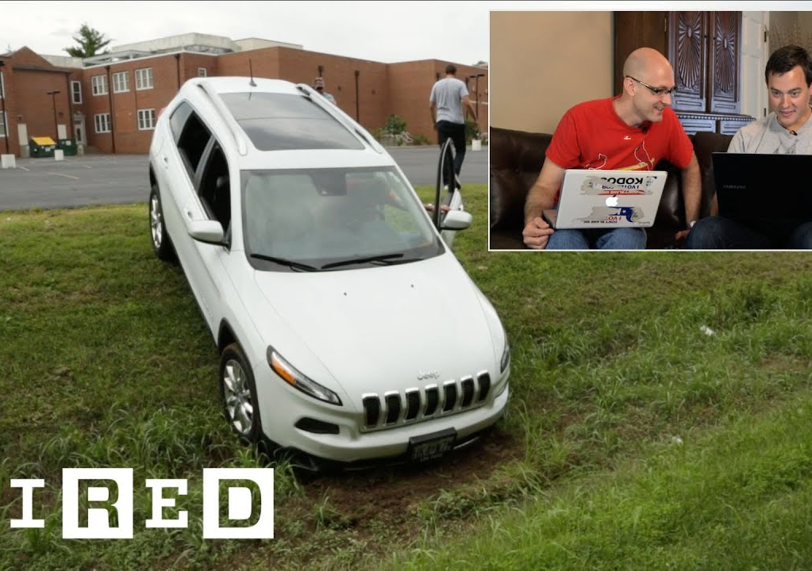
Jeep Hack
Attacker took over the steering wheel.
Managed to stop the car.
Causing Jeep company to recall 1.4 million vehicles
THIS IS A SERIOUS THREAT !!!
Notes:
A good example of that is the Jeep hack, where researchers took over the steering wheel and managed to stop the vehicle on the road after that Jeep company had to recall 1.4 million vehicles. So, this is a serious threat.

Slide 10
Threats to CAV
OTA Updates
- Over-The-Air (OTA) represent significant
Ransomware
- Attack on vehicles (car owners, fleet)
-Attacks on supply chain (OEM, Tier 1s, Tier 2s, Dealer Network, Maintenance)
ECU
- Attackers can use ECUs including Engine (ECM), Powertrain (PCM), brakes (BCM), suspension (SCM), etc
Notes:
One of the threats can be over the air updates that lots of updates these days are over the air. Another threat can be Ransomware – what if a system in your vehicle is compromised and ransomware injected into the system. ECU attacks
For ECU(electronic control unit), specific elements in the vehicle, there might be airbag ECU, there might be engine and transmission, there might be braking vehicle access system issue. All of these are easy use that control specific flow of data

Slide 11
Threats to CAV
Cloud Service Providers
- Cloud service providers are a weak link
- Can be used to gather data
- can be used as an entry point to the vehicle itself
Attack on Connected & IoT Devices
- Real –time Car Teletmatics controllers
- Wireless media
-Entertainment devices
- GPS Jamming & Spoofing
- MMW radar attacks
- Relay & Spoofing attacks on LiDAR Systems
- Ultrasonic Sensors attacks
- External sensors
- Web interfaces Mobile & SMS APIs
DDoS
- IoT end points on wheels
- Botnets on wheels
Remote Hacking
- Wireless carjacking
- key Fob cloning
Notes:
Cloud services providers a lot of data is now in that cloud.--- Denial of services attack what if your vehicle's 10,000 vehicles are use for denial of service attacks, these are basically botnets on wheels. Remote hacking – wireless carjacking, key fob cloning those are potential hacks and attacks. Iot devices – what about the real time telematics controllers inlcuding car tracking, mobile data, car sharing, usage based insuarance systems- those are third party attack services. Other things like GPS jamming and spoofing- what if your GPS does not work. What about external sensors. I mentioned lot of attacks, bluetooth. All of these are attack services can be compromised so we really have to look at it from the cyber security perspective.

Slide 12
Defense Strategies
How to protect Autonomous vehicles against cyber attacks
Notes:
nowadays its relatively easy for cyber criminals to get access to AVS and all they need to do is exploit a single vulnerability of an autonomous car and they hack into the entire server. Experts think that it may never be possible to completely secure an AV due to their complex code

Slide 13
Strategies For The Vehicle Server and Software
Creating a unique password
Cities deploying multiple networks
Updating the vehicle software
Updating V2S and V2I communication standard
Notes:
a good chance your vehicle comes with a default password that might be easy for hackers to guess.
Depending on a single network puts connected vehicles at greater risk from potential attacks. By creating many small networks, cities can greatly reduce the risks.
To make things more challenging, autonomous vehicle cybersecurity defences need to be capable of dealing with threats in real time, recognizing malicious messages and stopping them from being distributed around the vehicle.The latest software for a vehicle will include the most up-to-date patches that will protect the vehicle from known threats.
V2V and V2I is communication between smart vehicles and infrastructures. Data should be analyzed for instant decryption or sending over to server which creates another route of attack for hackers but there needs to be a secure authentication layer to confirm that data is received through trusted sources.

Slide 14
Strategies For Sensors
Countering the Vulnerabilities of the GPS
Protecting The Lidar system
In Vehicle Camera Security
Voice Control Systems
Notes:
Current vehicle GPS systems are easily hacked through what’s known as “GPS spoofing”. This is where a bad actor interferes with a GPS location system by using a radio signal. When a spurious signal is detected in the satellite, the system should identify it as a potential attack. The counterfeit signal can be detected using a signal strength detector, clock information and time intervals.
The lidar system can be protected from attacks by employing defense mechanisms such as controlling how it receives and emits its signals. The attacker's laser could be blocked by reducing the receiving angle and only receiving the signal from a specific, predefined angle.
Cameras used in autonomous vehicles have some vulnerabilities because of their optical characteristics, making them difficult to fully secure. Some possible countermeasures include photochromic lenses, redundancy and near-infrared cutoff filters that could provide adequate protection.
The voice recognition system is integrated into the vehicle to record and receive instructions from the passengers. using improved authentication measures and hidden cameras to ensure that controls come from live speakers

Slide 15
Other Strategies
Machine Learning based Solutions
Blockchain based Solutions
Notes:
1. As with all applications of machine learning, the first step to deploying artificial intelligence to combat security risks in autonomous vehicles is collecting and storing the right data. If a car’s internal network is monitored using a platform capable of storing and analyzing logs, the vehicle itself can detect malicious activity and prevent attacks
2. Blockchain technology is praised for its decentralized nature that can be used to transact vehicular data with a high level of security. Blockchain platforms provide a reliable means of collecting data and delivering it in a secure and immutable state. The data is stored cryptographically, ensuring a high level of security. By using a permissioned network, specific data can only be accessed by parties with permission. This ensures that the sensitive data does not reach the wrong hands and is misused.

Slide 16

Questions?

Slide 17
Thank You…

Slide 18
References
D. Causevic, “How machine learning can enhance cybersecurity for autonomous cars,” Toptal Insights Blog, 21-Jul-2017. [Online]. Available: https://www.toptal.com/insights/innovation/how-machine-learning-can-enhance-cybersecurity-for-autonomous-cars.
J. Giordani, “Council post: Cyberattacks on vehicles pose a threat to drivers and manufacturers,” Forbes, 21-Apr-2022. [Online]. Available: https://www.forbes.com/sites/forbestechcouncil/2021/12/10/cyberattacks-on-vehicles-pose-a-threat-to-drivers-and-manufacturers/?sh=2c54efb64620.
P. Calomarde, “Bench talk,” Cybersecurity in Self-Driving Cars: Helping to Prevent Hacking |, 19-Jun-2017. [Online]. Available: https://www.mouser.fr/blog/cybersecurity-in-self-driving-cars-helping-to-prevent-hacking.
“Six ways to protect against autonomous vehicle cyber attacks,” IEEE Innovation at Work, 07-Sep-2020. [Online]. Available: https://innovationatwork.ieee.org/six-ways-to-protect-against-autonomous-vehicle-cyber-attacks/.
“Six ways to protect against autonomous vehicle cyber attacks,” IEEE Innovation at Work, 07-Sep-2020. [Online]. Available: https://innovationatwork.ieee.org/six-ways-to-protect-against-autonomous-vehicle-cyber-attacks/.

